Slide 1
Criminal Law Data Analysis – Puerto Rico Edition
Donnie Aikins
Presentation I

Slide 2
Mentor
Carlos Paniagua, Salve Regina University
carlos.paniaguamejia@salve.edu
Researcher
Diego Alcala, Defensoría Legal
dalcala@defensorialegal.com

Slide 3
Criminal Law Data Analysis – Puerto Rico Edition
United States District Court of Puerto Rico
Puerto Rico Association of Criminal Defense Lawyers (compiled documents via PACER System)
Visualizations
length of time that the case is "open"
% of persons represented by a court-appointed attorney
average length of sentences
etc..

Slide 4
Goals & Timeframe
Project Goals
Visualization of Dockets & Indictments
Analysis of trends amongst supreme court reports
Timeframe
Start Date: 10/01/2021
End Date: 03/31/2022

Slide 5
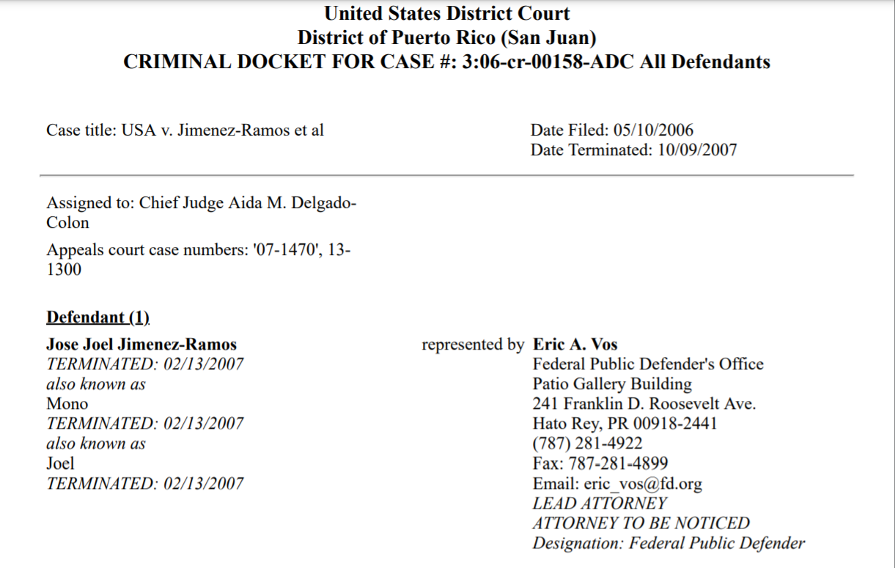
Docket Sheets
Variables of analysis
Dates [start, end]
Case Number
Case Title etc…
Structure of Data
CSV/XML file

Slide 6
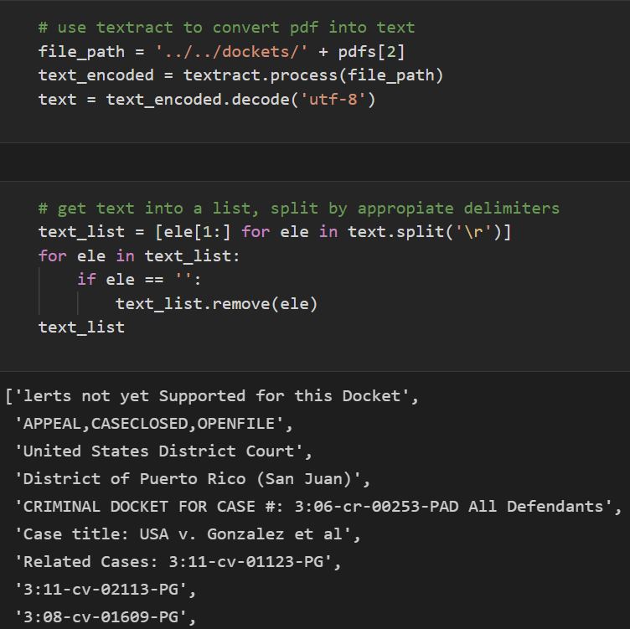
Exploratory Analysis of Length of Cases
Initial Decision
Extract information from all docket sheets
Structure into csv file
Headers: Case Number, Start Date, End Date
Python
Pandas, Textract, Pyplot etc…
GitHub

Slide 7
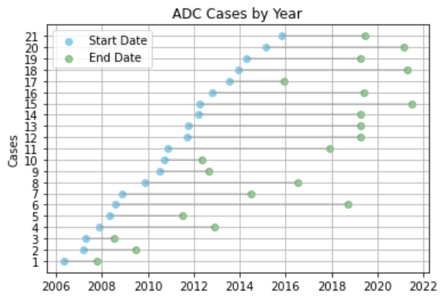
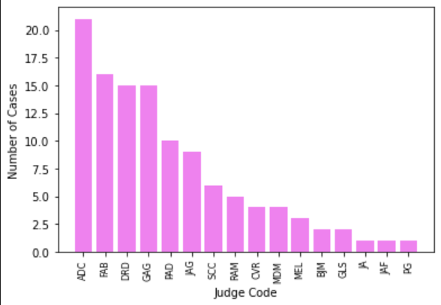
Results
Length of cases per Judge
Cleveland Dot Plot
X axis: Year {month included depending on short cases}
Y axis: Number of cases
Aida M. Delgado Colon had the most cases
Why? More variable exploration?
Distribution of cases not evenly spread

Slide 8
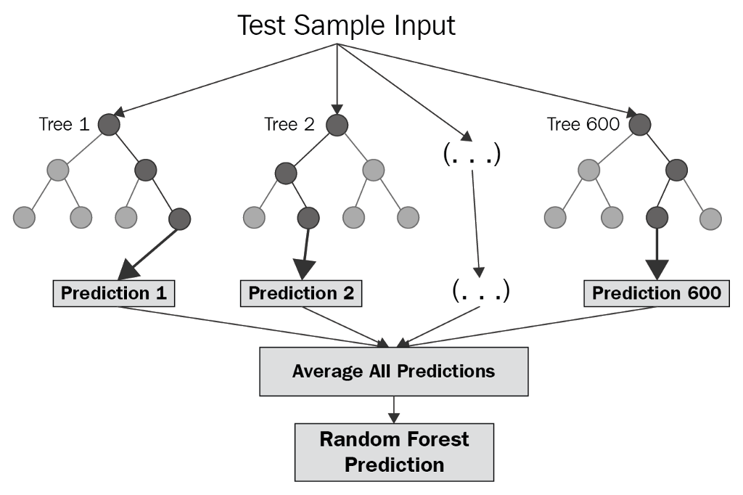
Further Analysis
Goals for Next Month
More variable analysis
Judge Code, Defendant & Sentence
Explore modelling
Statistical testing
Modelling
Is Judge X likely to do Y for future cases? Random Forest Model?
Statistical testing
Chi Squared
ANOVA

Slide 9
Feedback
Questions?
Suggestions?

